Slide 1
Drupal 8 – Installing the Address Module on a Web Host
Setting up SSH on SiteGround
Installing Composer
Using the composer over an SSH terminal connection to install the Address Module

Slide 2
The Address Module is required for CSV Data Import of Address Data
The problem is that we can not just save off the Address module’s URL and go into Drupal 8 and install it
Instead we must get to a command line and run 2 composer commands
(1) composer config repositories.drupal composer https://packages.drupal.org/8
(2) composer require "drupal/address ~1.0"

Slide 3
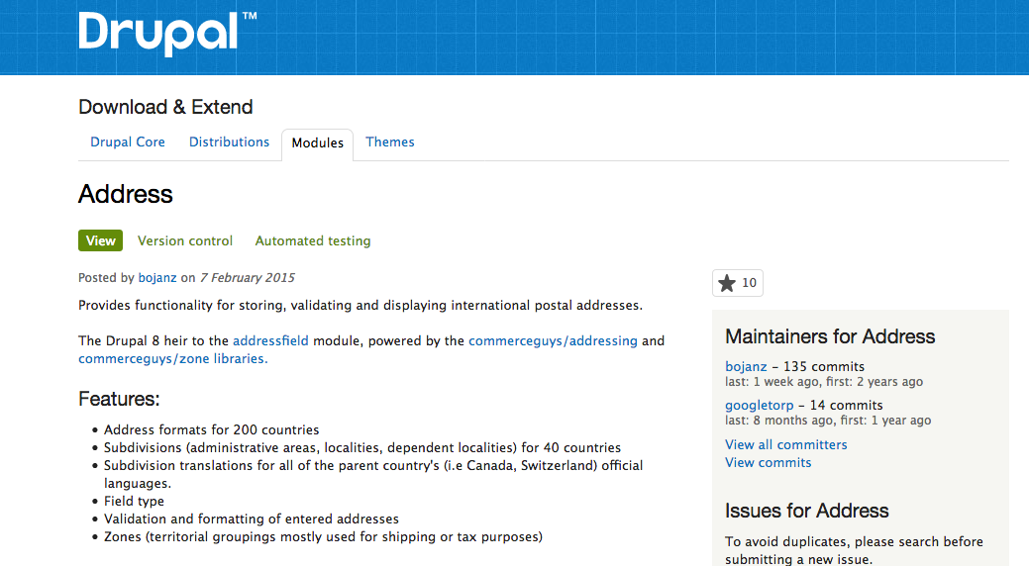
Drupal Project Page for the Address Module

Slide 4
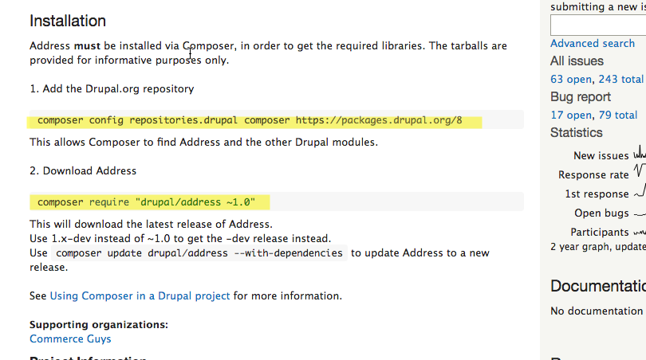
Second page where it gives up the bad news about having to install via composer

Slide 5
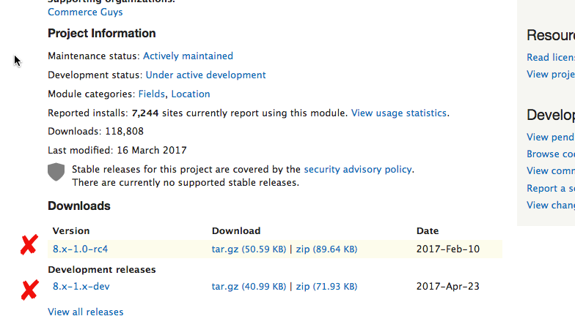
The last page with the tar.gz and .zip files that we can not use to install

Slide 6
Part 1 – Gainng access to SiteGround Web Host Command Line via SSH
SiteGround does not give you command line access out of the box
To get command line access to your SiteGround account and CMS sites you have to establish an SSH key, add it to the computer you intend to connect to SiteGround with and use a Terminal app to connect to SiteGround over a secure socket via SSH
Sounds simple enough. And I’m on a Mac

Slide 7
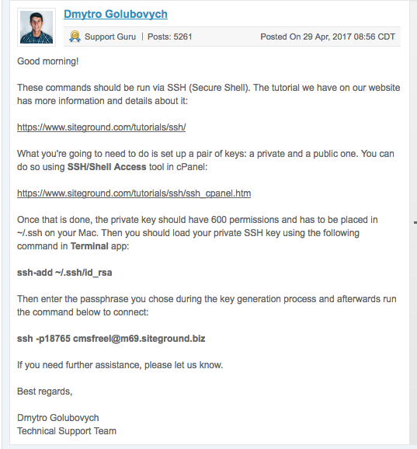
I had to ask SiteGround about how to do the SSH. Here is there reply

Slide 8
Steps To Establish Command Line Access to SiteGround
Login to SiteGround
Access the cPanel
Scroll down to the Advanced panel
Select SSH/Shell Access
Fill out the form, use the Generate password button to generate the password, and then immediately save the password (AKA: passphrase) off to a safe file and location
Generate the Private Key & #.private key file

Slide 9
Steps To Establish Command Line Access to SiteGround
On the SiteGround cPanel, find the Files section
Open the File Manager
Find the .ssh folder and our new #.private file
Download the #.private file to my Mac
On the Mac open a Teminal window
Copy the #.private to ~/.ssh folder
Chmod the #.private file to 600 (in ./ssh)
Run the command ssh-add /.ssh/#.private
Enter the password for the passphrase
Access SiteGround via the ssh command
ssh –p<PORT> <username>@<webhost URL or IP>

Slide 10
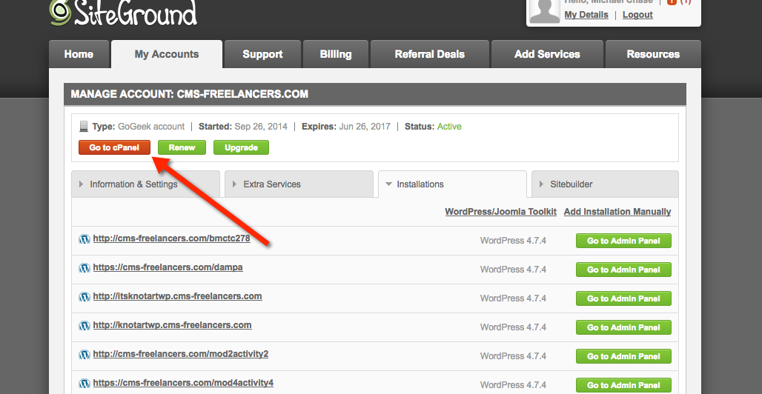
Login to SiteGround, Access the cPanel

Slide 11
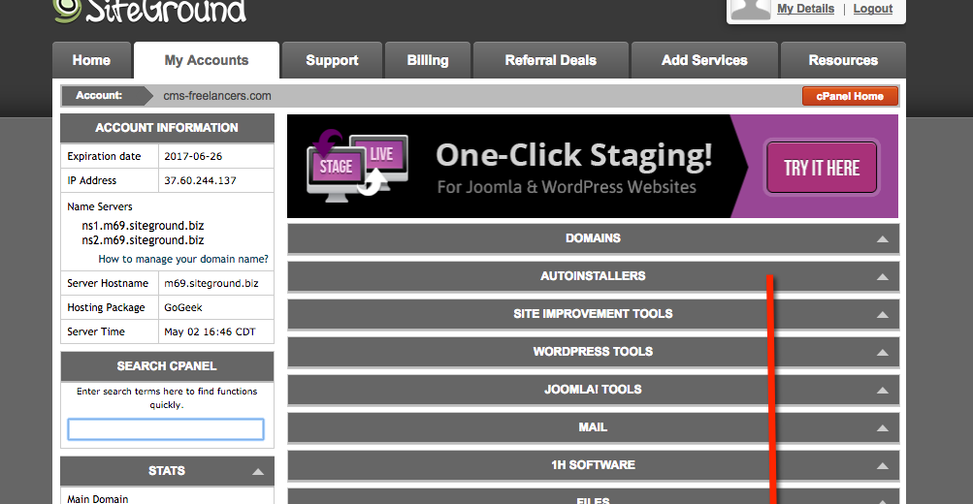
Scroll down to the Advanced Section

Slide 12
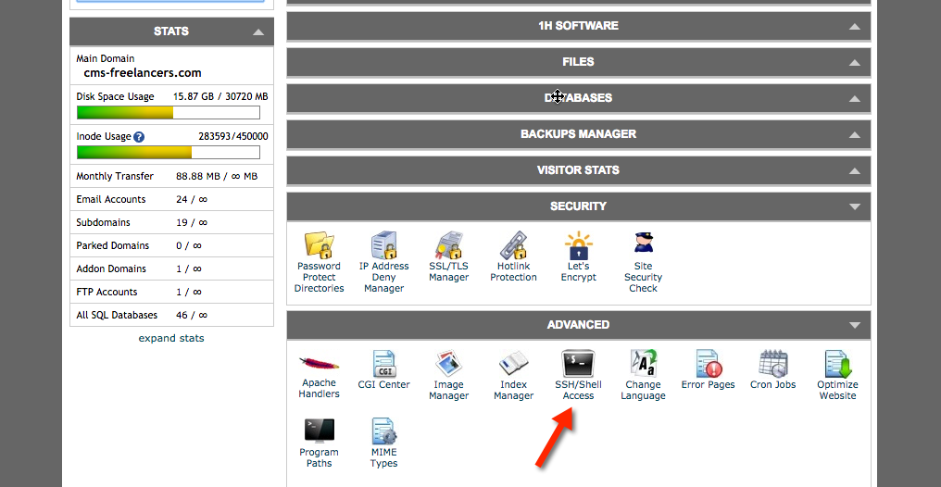
Select SSH/Shell Access

Slide 13
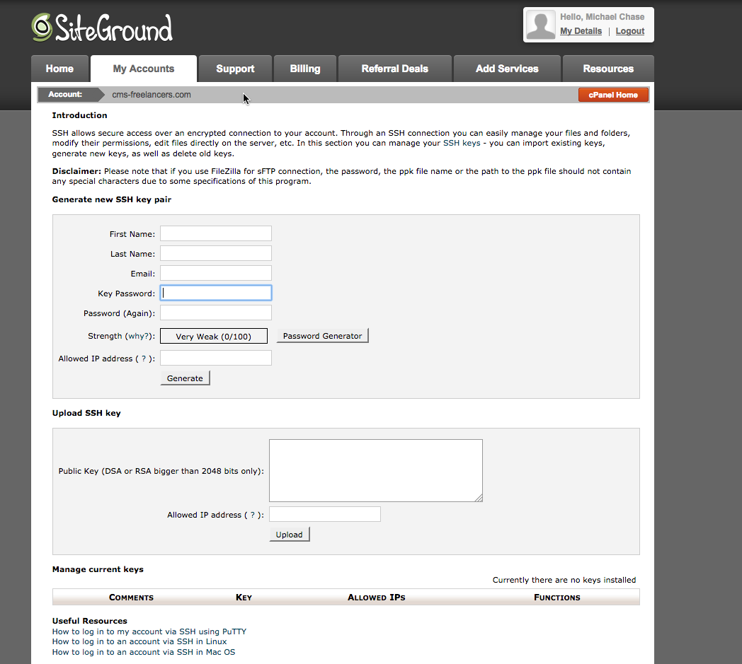
Fill out the Form

Slide 14
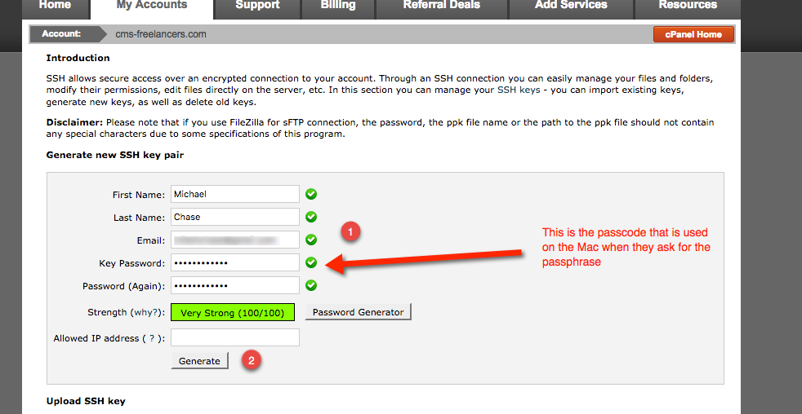
I used the Password Generator button to create a strong password Im not ading an IP address as I want access form multiple points Last I pushed the generate button

Slide 15
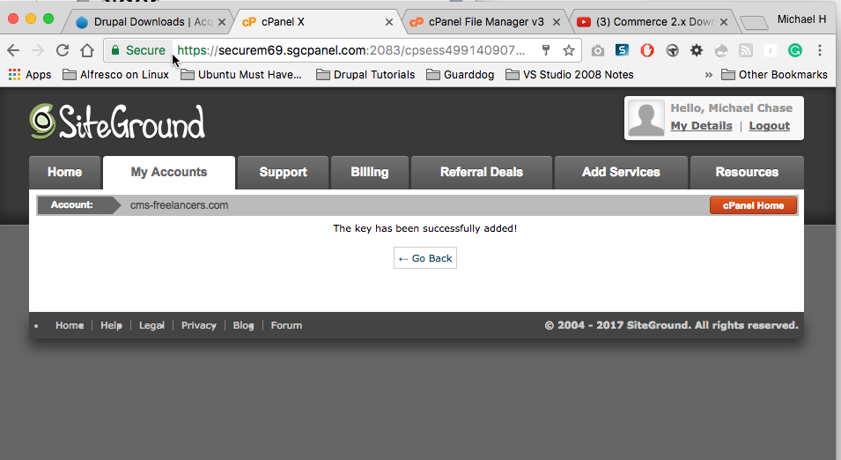
Key Generated, Go Back

Slide 16
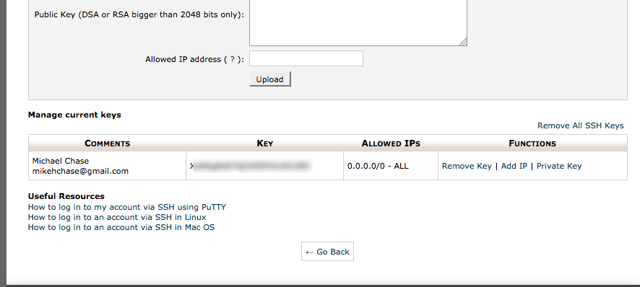
The password on the previous page is also known as the passphrase. The key is the Private Key

Slide 17
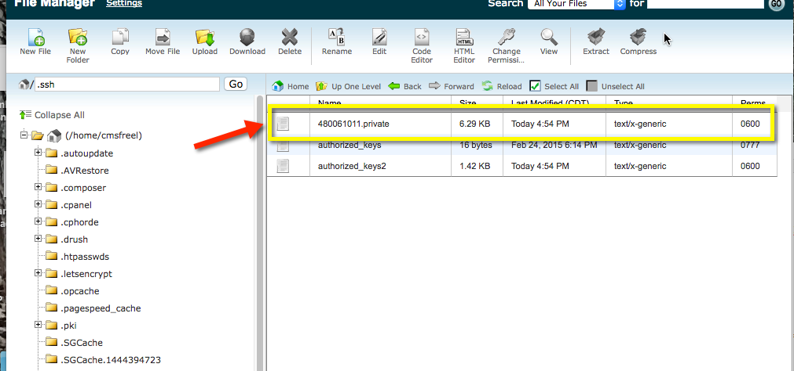
Once you click Generate, a #.private file is created on the SiteGround .ssh folder

Slide 18
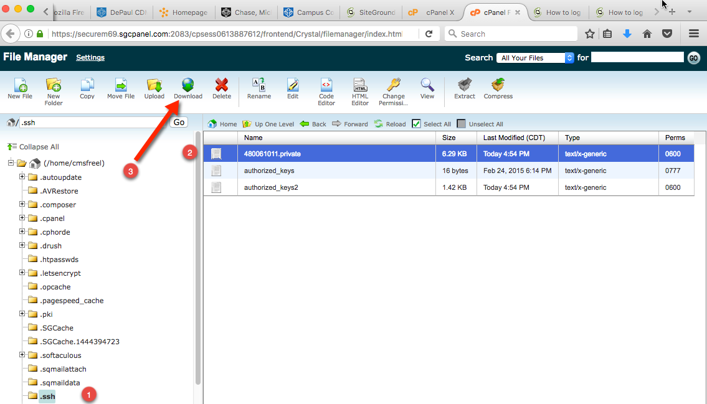
Select the #.private file and download it to your computer (the one you intend to use for connecting to SiteGround with)

Slide 19
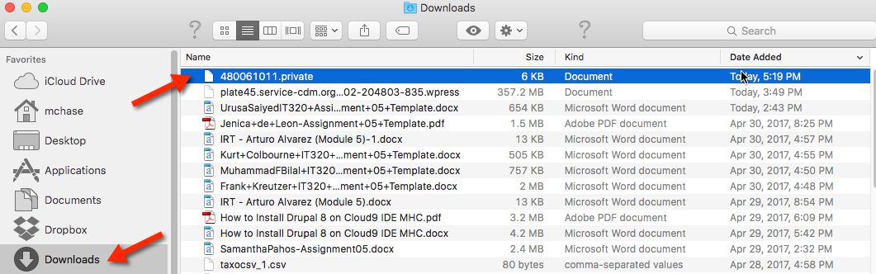
You can see the #.private file has been downloaded, what you can not see, is that its permissions have been changed, its no longer 600

Slide 20

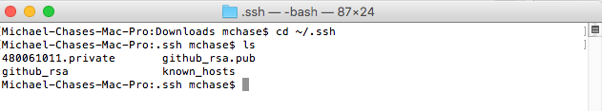
Im copying the #.private file from Downloads to ~/.ssh

Slide 21
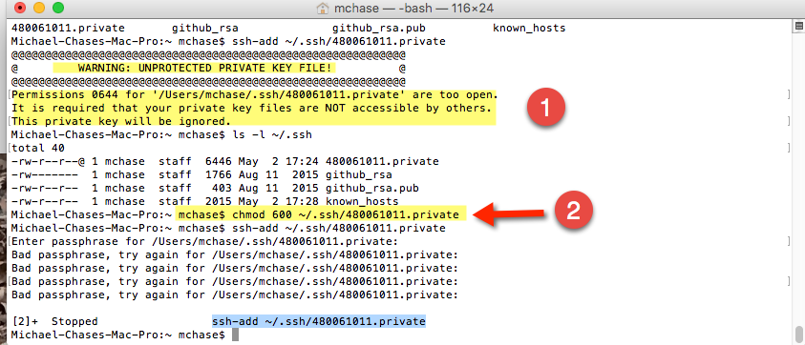
(1) First attempt to run add the private key command “ssh-add” fails because the #.private file is permissioned correctly it must be 600. So next step (2) is to chmod the file to 600

Slide 22
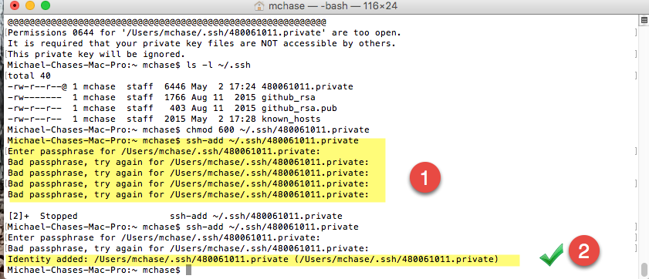
Second attempt to run “ssh-add” command is successful, after I learn that the PASSWORD is what they want for passphrase

Slide 23
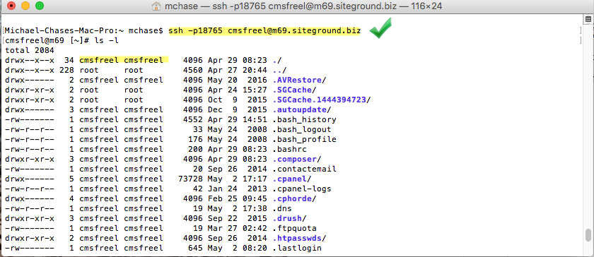
With Private key Established, successfully logon to SiteGround using SSH command line ssh –p18765 cmsfreel@m69.siteground.biz

Slide 24
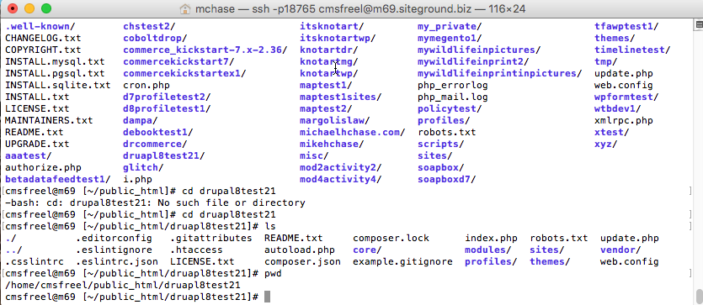
On my terminal connection window, access the Drupal site folder “druapl8test21” (poorly spelled druapl8test21)

Slide 25
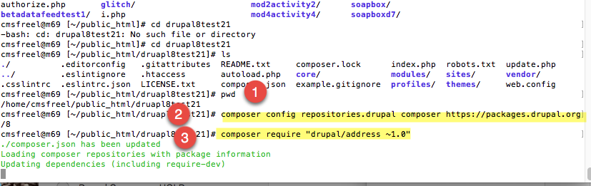
(1) Navigate to eh Drupal site folder (2) Run the first composer command (3) Run the second composer command

Slide 26
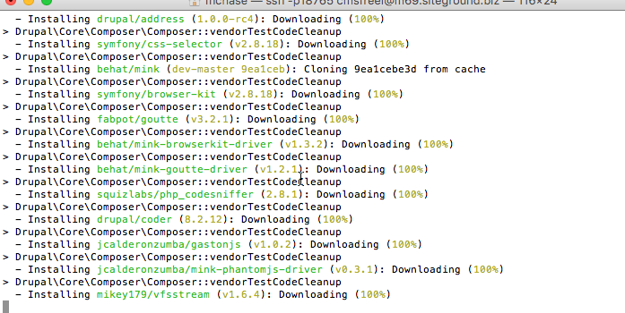
Composer command #2 running

Slide 27
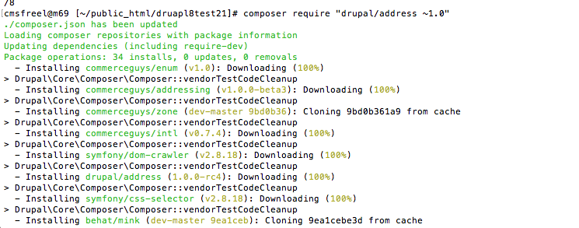
Composer command #2 is still running

Slide 28
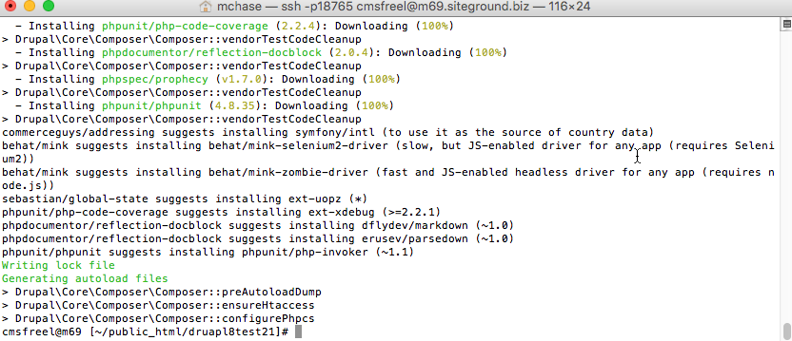
Composer is done install Address

Slide 29
Go back to the Drupal CMS Site
login as the Site Admin
Admin menu Extend
Shrink up Core and Core Experimental
THERE IS the Address Module
Select it and install it

Slide 30
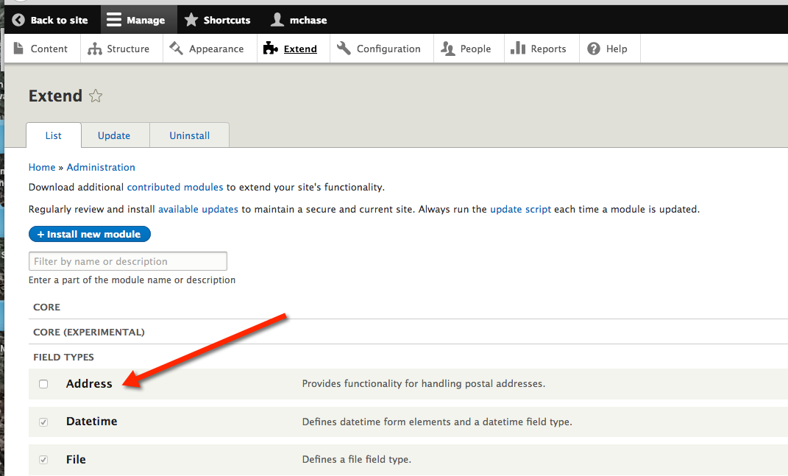
Enable the Address Module

Slide 31
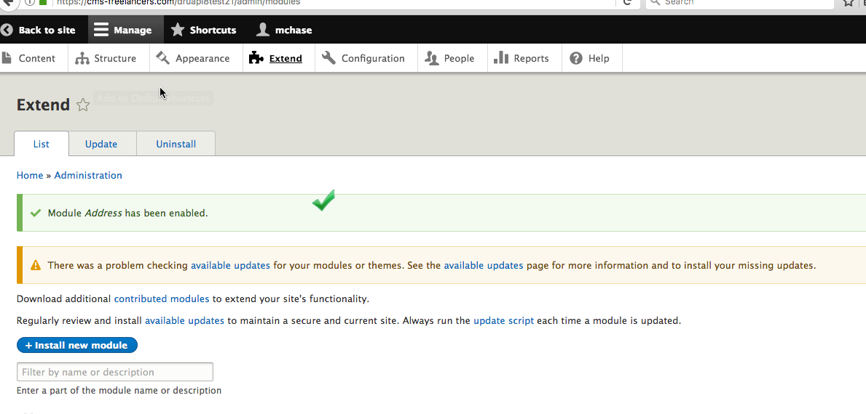
Address Module and all required Libraries have been installed

Slide 32
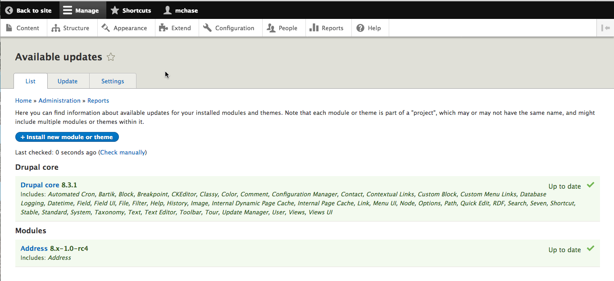
Select the Update TAB on Extend: Address is up to date, so we know the composer install worked correctly

Slide 33
Drupal Project Page Address Module
https://www.drupal.org/project/address

Slide 34
The Two Composer Commands
composer config repositories.drupal composer https://packages.drupal.org/8
composer require "drupal/address ~1.0"

